Slide 1
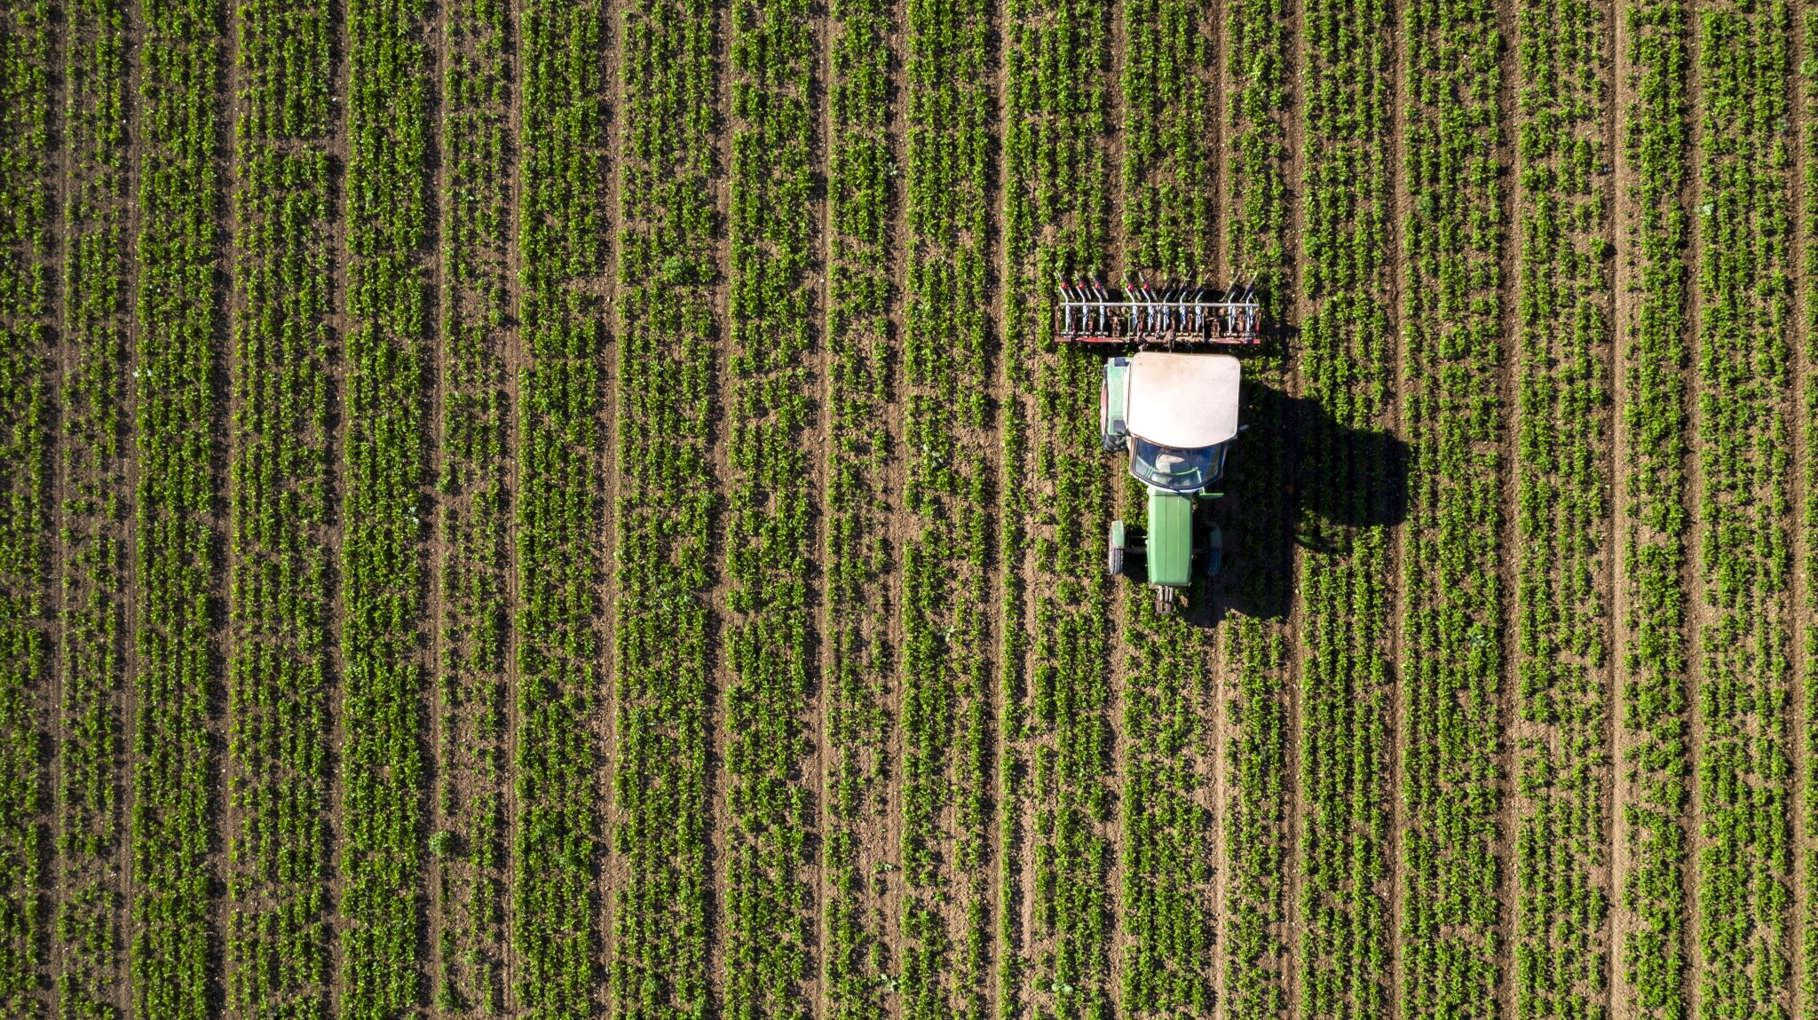
Farmers market User Experience
Ideas for features and design

Slide 2

Interactive map
An interactive map will help users to find everything they are looking for.
showing who is at each stall and what they are selling with a popup on hover with more information

Slide 4

Vendor’s profile
Seller profiles will tell customers what each seller has in stock.
Each vendor's profile will contain additional information about their farm and the array of products they offer.

Slide 5


Slide 6

Customer Profile
Customer profiles allow customers to favorite certain vendors.
Customers can also order online and pickup without hassle.

Slide 7
